Slide 1




NEXT GEN EMPLOYABILITY PROGRAM
Creating a future-ready workforce
Team Members
College Name
Student Name :ABI MONIFA AP
Student ID : au960221104004
Arunachala College Of Engineering For Women

Slide 2

CAPSTONE PROJECT SHOWCASE
Project Title
Car Rentals Application with Django Framework
Abstract | Problem Statement | Project Overview | Proposed Solution | Technology Used | Modelling & Results | Conclusion

Slide 3
Abstract:
The project outlines the development of a web-based car rental application by using the Django framework. The application aims to streamline the car rental process for both customers and rental businesses, offering a user-friendly interface and efficient management tools.
Source :

Slide 4
Problem Statement:
Traditional car rental processes can be unmanageable and time-consuming . Limited availability of real-time information on vehicle options and pricing . Manual booking management prone to errors and inefficiencies.
Source :

Slide 5
Project Overview:
*Specify the target audience and their needs, like individuals looking to rent cars for personal use or businesses needs.
* Implement registration, login, and password reset functionalities for both customers and admin staff.
*Create user manuals and developer documentation to assist users and future developers.
*Deploy the application to a production environment and monitor performance and stability.
Source :

Slide 6
Proposed Solution:
.
*Develop Django models for Cars, Customers, and Rentals . Implement functionalities for car search, booking, user management, and admin panel.
*Integrate a user authentication system for secure login and account management . This proposed solution offers a comprehensive foundation for your car rental application. We can customize and extend it further based on our specific requirements and desired features.
Source :

Slide 7
Creating a Next Gen Employability program for a car rentals application involves several components:
Skill Development: Identify key skills required for roles within the company, such as customer service, sales, vehicle maintenance, and administration.
Training Modules: Develop training modules focusing on these skills, including both theoretical knowledge and practical application.
Technology Integration: Incorporate training on using the car rentals application effectively, including booking management, vehicle tracking, and customer communication features.
Soft Skills: Include training on soft skills like communication, problem-solving, teamwork, and adaptability, essential for success in any role.
Source :

Slide 8
Mentorship Program: Pair new hires with experienced employees to provide guidance and support throughout their training period.
Assessment and Feedback: Implement regular assessments to track progress and provide constructive feedback to employees, helping them improve continuously.
Career Path Development: Offer opportunities for advancement within the company, with clear pathways and development plans for employees to progress in their careers.
Continuous Learning: Encourage a culture of continuous learning and skill development through ongoing training sessions, workshops, and access to online resources.
By implementing these components, the Next Gen Employability program can effectively prepare employees for success within the car rentals application, enhancing their employability and contributing to the company's overall success.
Source :

Slide 9


Technology Used
Front-end
Back-end
Source :

Slide 10
Modelling & Results:
Define Django models with relevant fields for Cars, Customers, and Rentals . Develop views and functionalities for user interaction and data manipulation . Utilize Django templates or a front-end framework to create a user-friendly interface . We can define a clear structure for storing and managing car rental data . Establish relationships between cars, customers, and rentals, allowing you to efficiently query and retrieve relevant information. Django enforces data validation rules within models, ensuring data consistency and reducing errors.
Source :

Slide 11
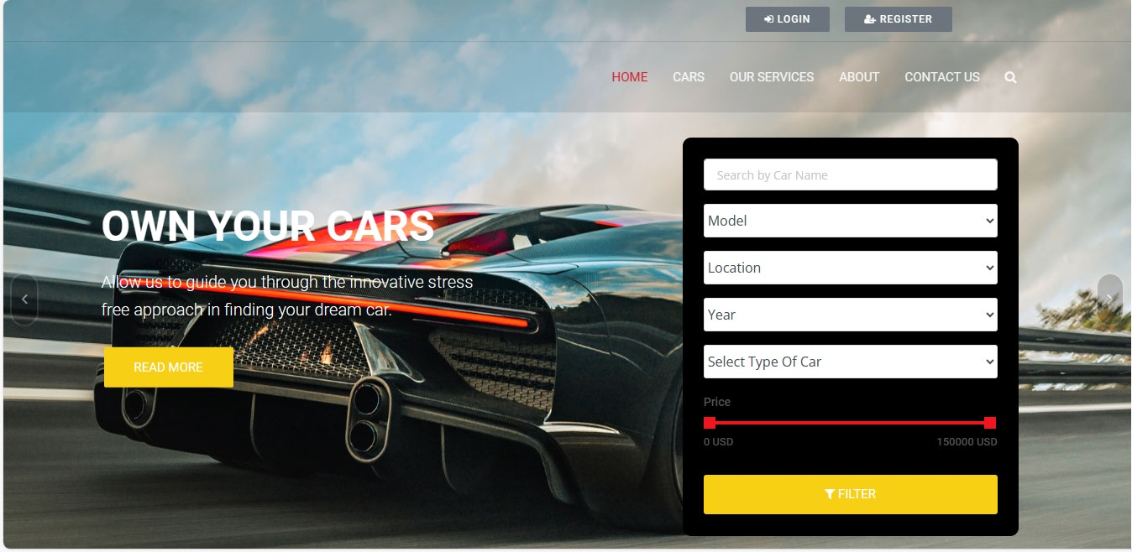
Homepage

Slide 12
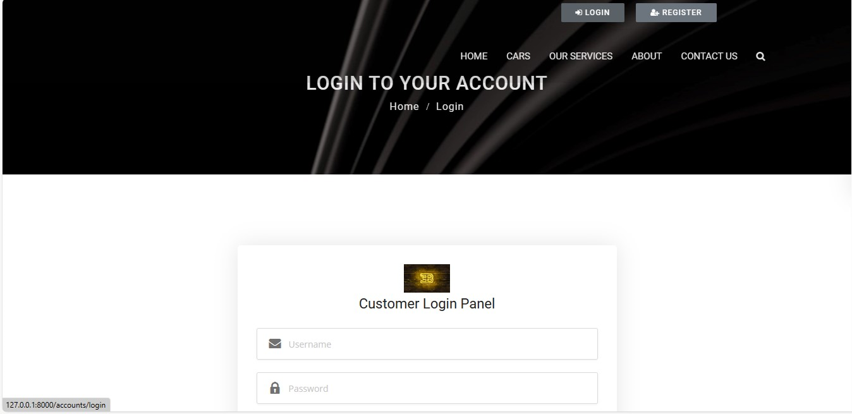
Login Page

Slide 13
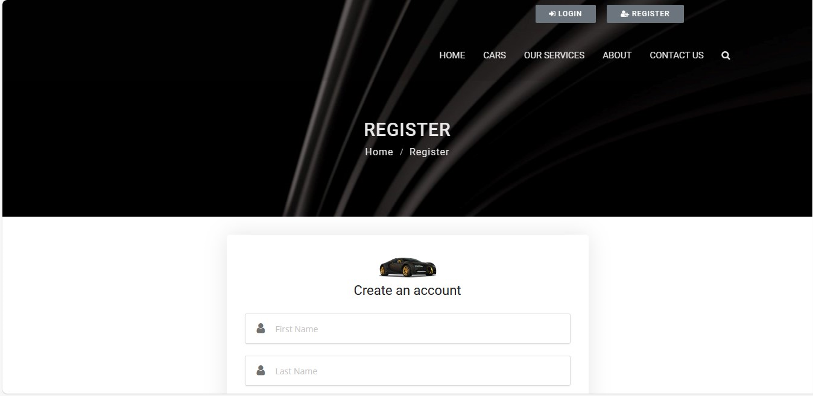
Register Page

Slide 14
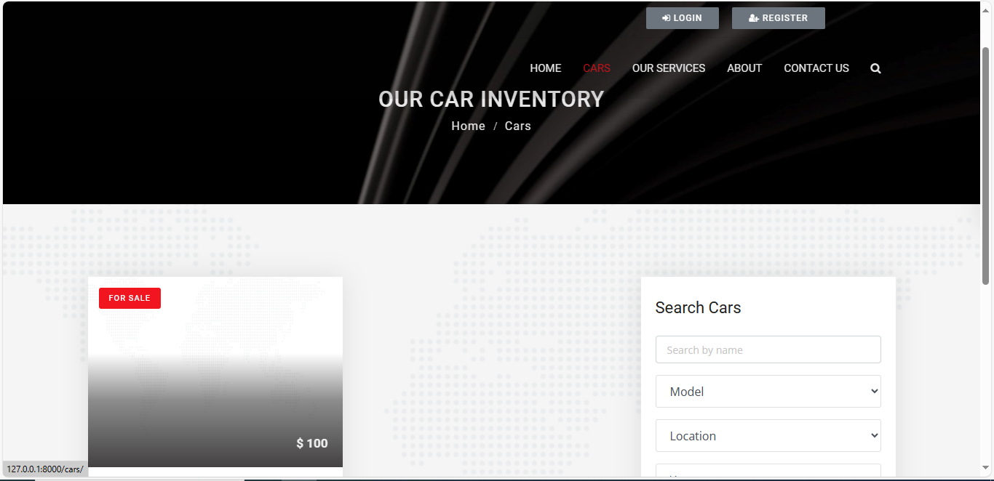
Our Car Inventory Page

Slide 15
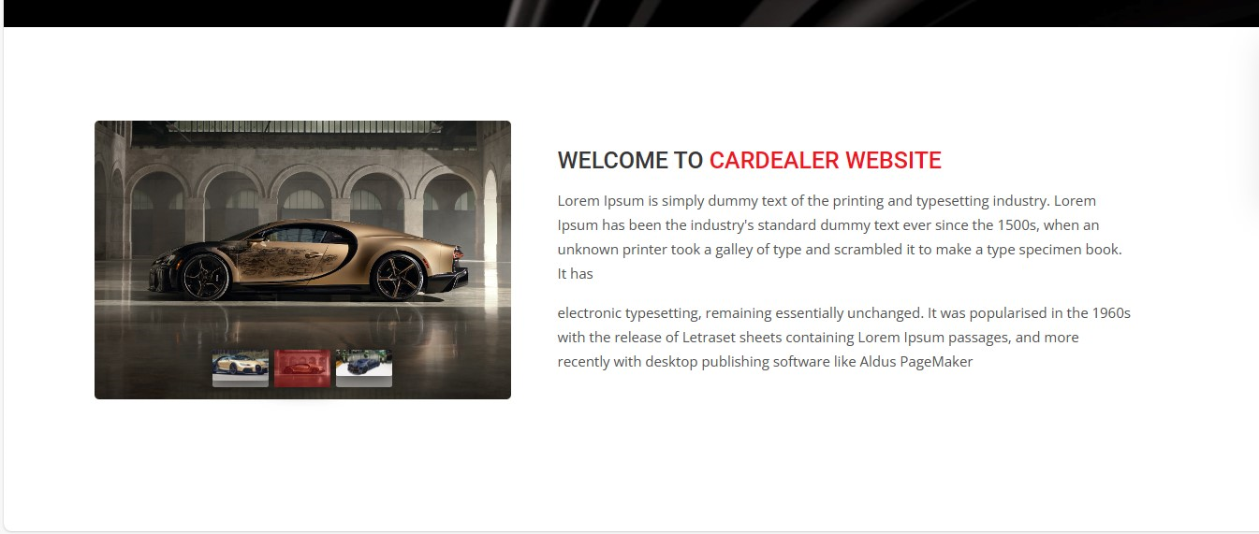
About Us Page

Slide 16
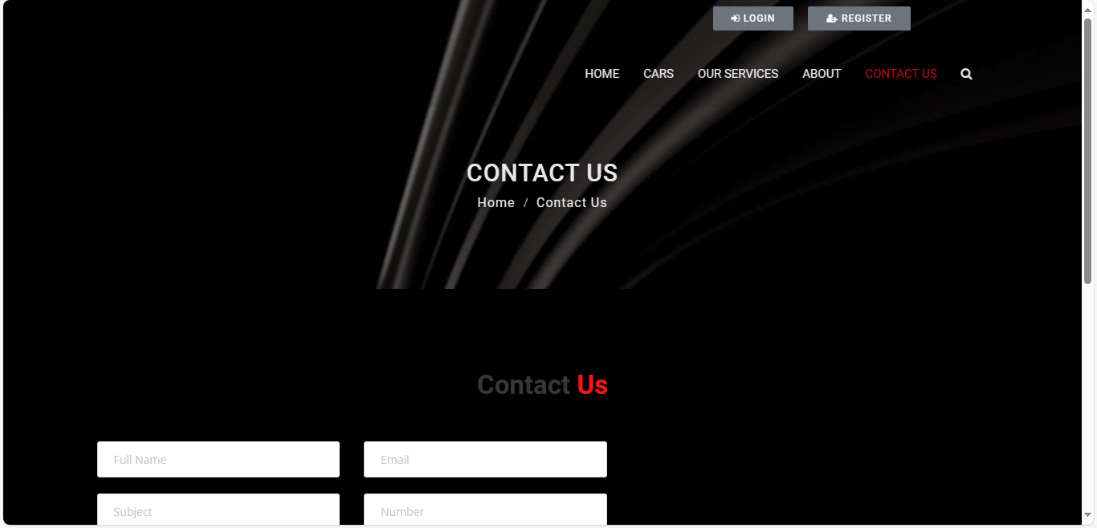
Contact Us Page

Slide 17
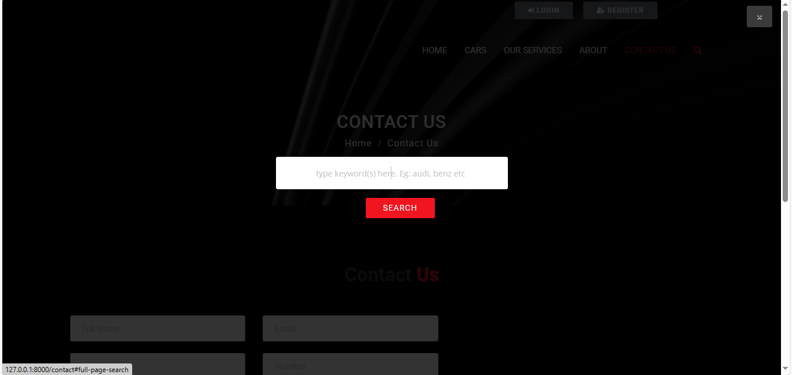
Search Page

Slide 18
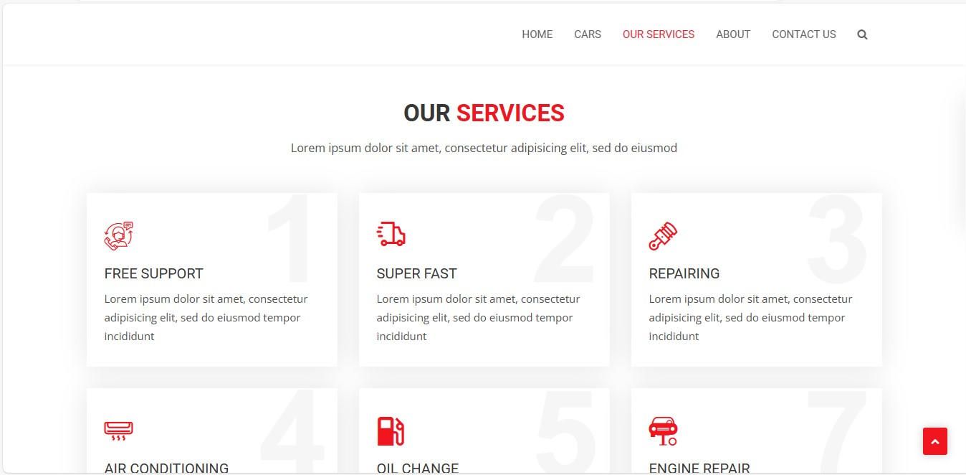
Service Page

Slide 19
Future Enhancements:
One-way Rentals: Allow users to pick up a car at one location and drop it off at another . Subscription Model: Introduce a subscription model where users can pay a monthly fee for unlimited rentals within a specific timeframe . Loyalty Program: Implement a loyalty program to reward frequent renters with discounts or other perks . In-car Entertainment Integration: Integrate with in-car entertainment systems to allow users to access music, navigation, or other services during their rental period . Carpool/Ridesharing Features: Expand the platform to include carpooling or ridesharing functionalities, allowing users to connect with others for shared rentals . These are just a few ideas to get you started. By focusing on user experience, automation, and innovative features, we can create a future-proof car rental application with Django.

Slide 20
Conclusion:
The proposed car rental application built with Django offers a user-friendly and efficient solution . Customers benefit from a convenient platform for searching, booking, and managing car rentals . Rental businesses gain efficient tools for managing their fleet, customer interactions, and potentially streamlining online payments . Django's robust framework provides a solid foundation for building a scalable and secure application that can grow with the demands of the car rental industry.
Source :

Slide 21
Thank You!
Notes:
Thank You !!

